Slide 1





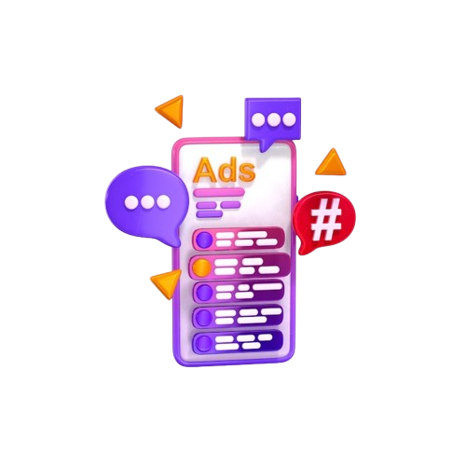
Digital Marketing Assignment
Black Velvet Chocolate
Meta Ads
Niharika Singh
BCA – 3rd Semester
Session – 2026 - 2027

Slide 2

Digital Marketing
Assignment Report
ASSIGNMENT FOLIO
Assignment Folio of
Digital Marketing
Submitted to
Dezyne École College
Toward Digital Marketing
By
BCA
3rd Semester
Niharika Singh
Dezyne École College
106/10, Civil Lines, Ajmer
www.dezyneecole.com
2026 - 2027

Slide 3
Digital Marketing
Assignment Report
ASSIGNMENT FOLIO
We take this opportunity to express our sincere gratitude to Dezyne École College for providing us with the knowledge, resources, and guidance essential to the successful completion of this project.
Our deepest thanks to our respected Principal, Dr. Vinita Mathur, for her visionary leadership and continuous encouragement. Her commitment to academic excellence and student growth has been a constant source of motivation and pride.
We are equally thankful to all our faculty members for their consistent support, expert advice, and valuable insights that shaped our learning and helped us achieve this milestone.
Lastly, we extend heartfelt thanks to everyone who directly or indirectly contributed to the success of this project.
We are proud to be part of Dezyne École College, an institution that truly nurtures professionalism, innovation, and purpose.
With sincere appreciation,
Niharika Singh,
Department – BCA
Dezyne École College, Ajmer

Slide 4
Digital Marketing
Case Study
ASSIGNMENT FOLIO
Objectives:
Increase Instagram Profile Visits, Boost Brand Awareness, Grow Followers Organically, Increase Engagement Rate & Improve Content Reach.
Key Feature:
1. Traffic Campaign Objective
Selected the "Traffic" objective in Meta Ads Manager to drive Instagram profile visits.
2. Audience Targeting
Targeted users based on age, interests, behavior, and location.
3. Engaging Creative Content
Used eye-catching Reels, carousel posts, and strong captions.
4. Call-to-Action Button
Used "Visit Instagram Profile" to direct users instantly.
5. Performance Tracking
Monitored metrics like CTR, Profile Visits, CPC, and Engagement Rate.

Slide 5



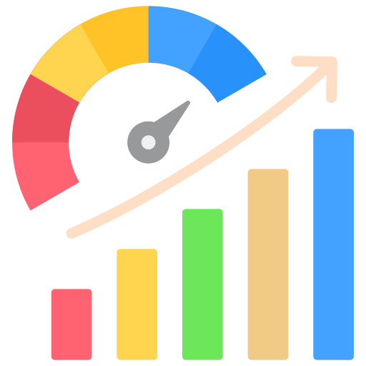





Audience Research And Segmentation
Campaign Objective Selection
Add Sets Creation And Targeting
Conversion Tracking And Champion Optimization
Ad Creative Design And Optimization
Meta
Ads Campaign
Landing Page Optimization
Budget And Bidding Strategy
Audience Expansion And Retargeting
A/ B Testing And Creative Enhancement
Tracking And Performance Monitoring

Slide 6
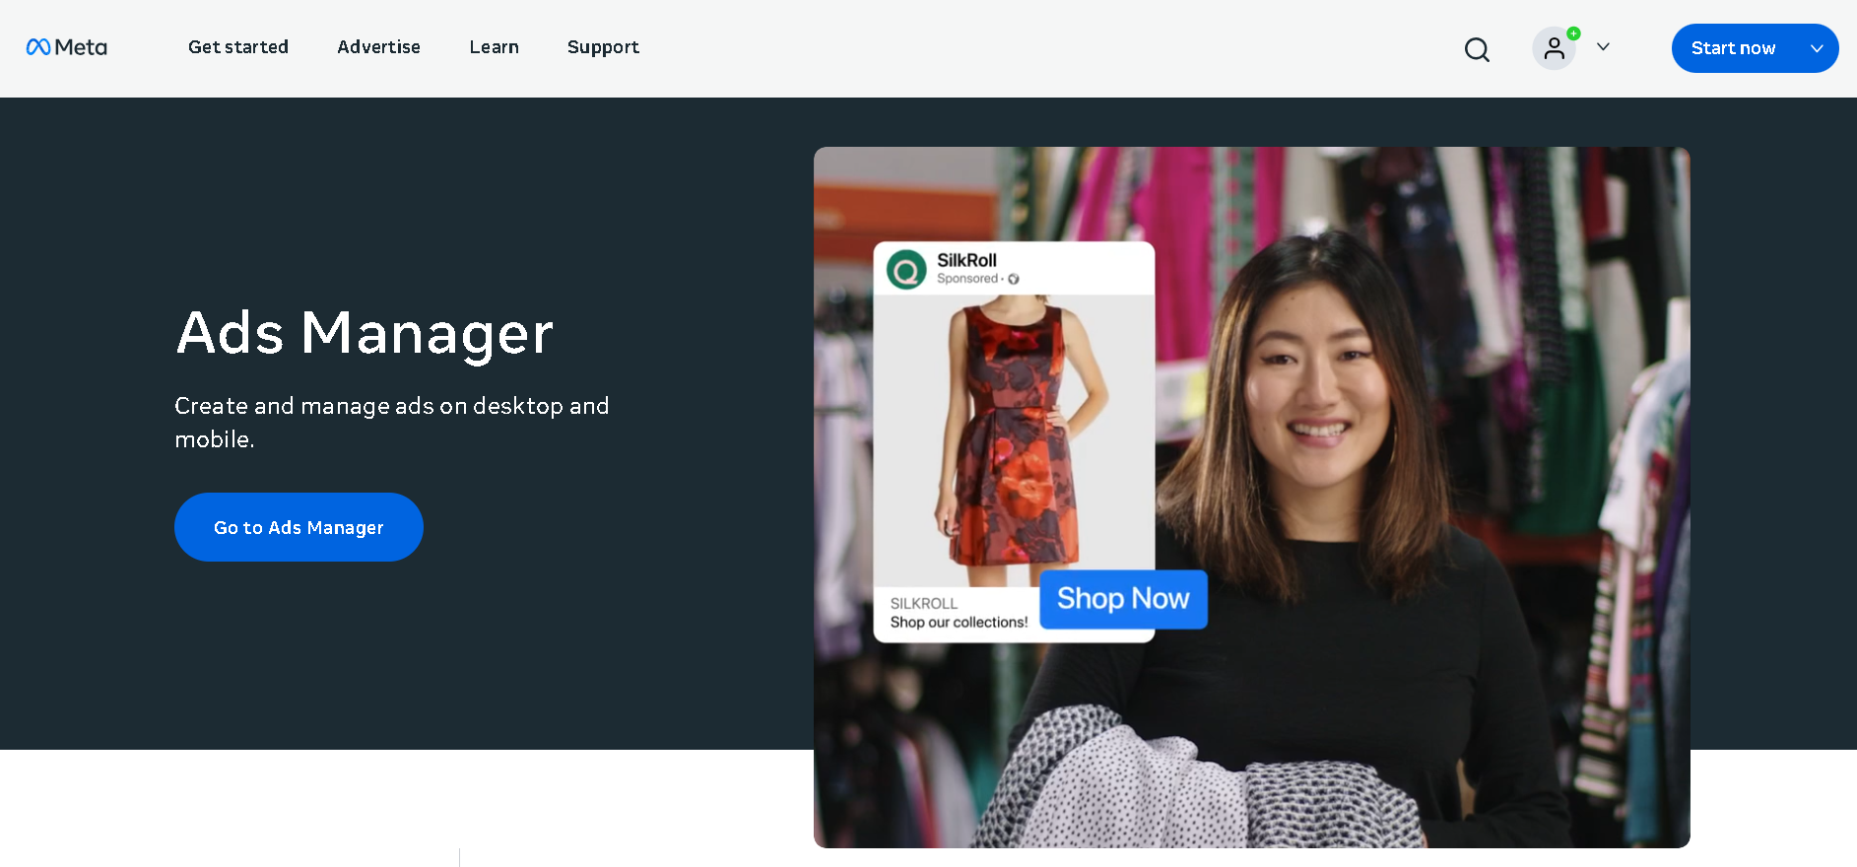
Meta Ads Platform - Overview

Slide 7
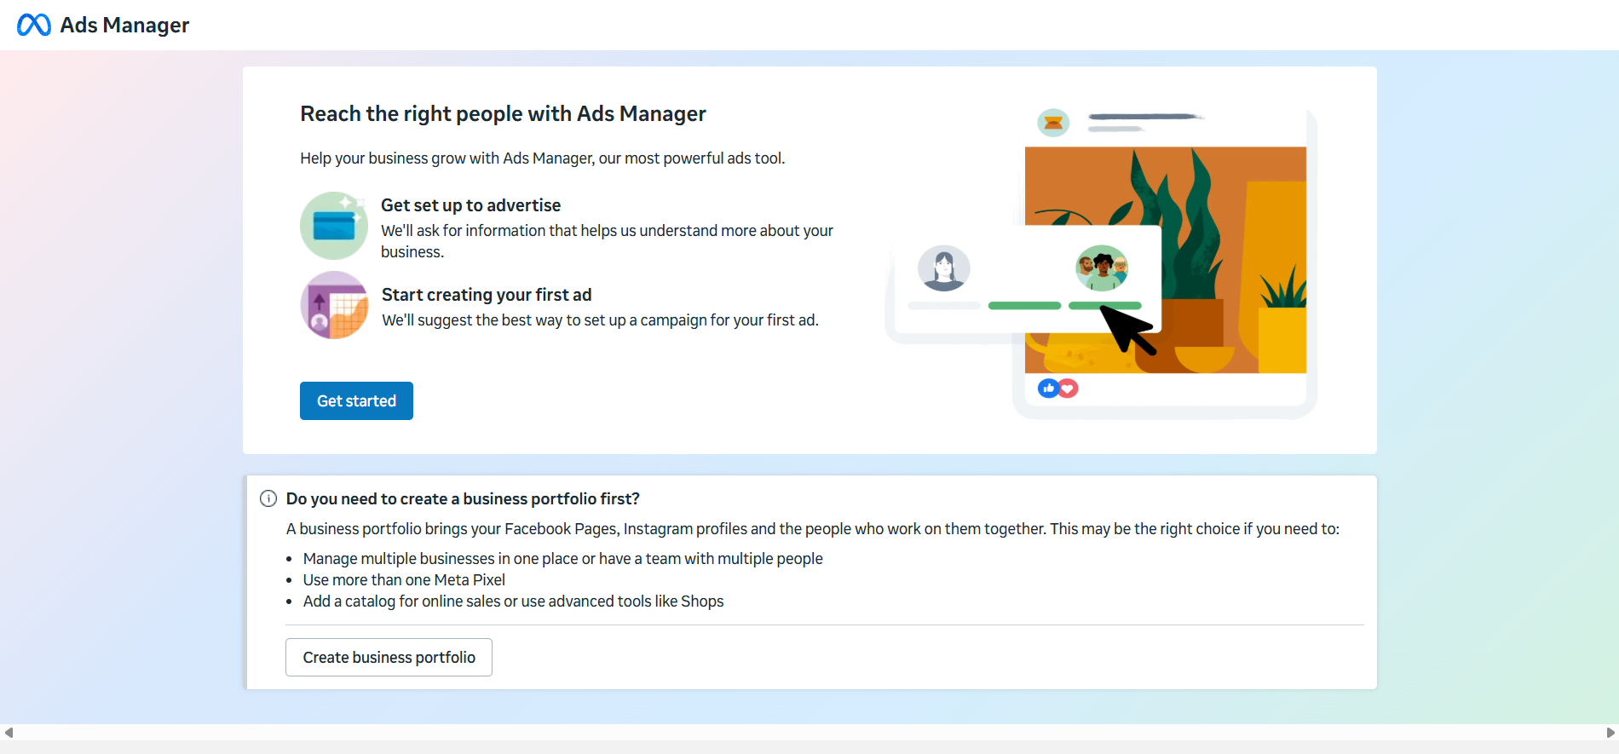
Reach The Right People

Slide 8
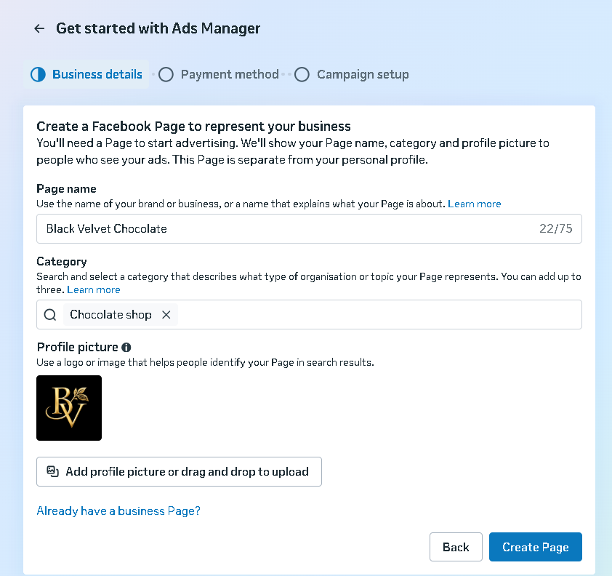
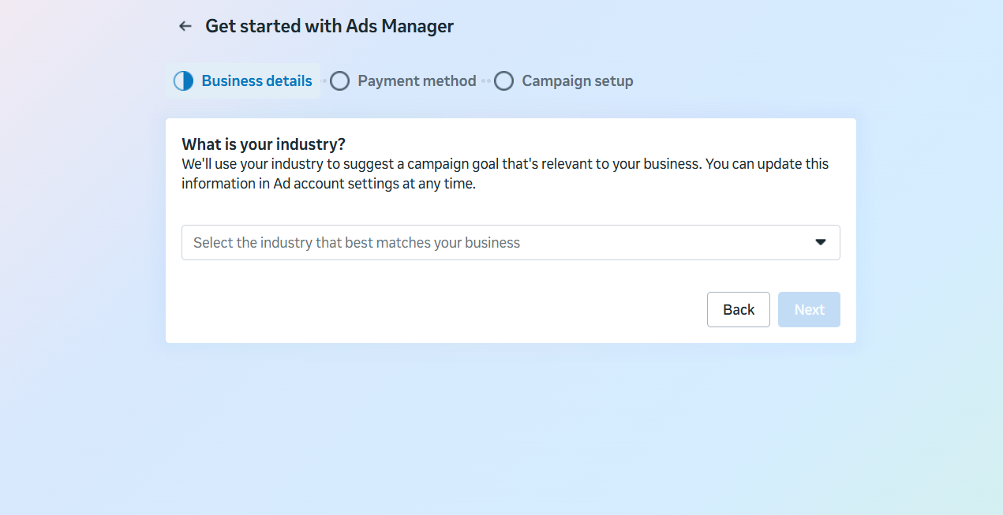
Get Started with Ads Manager

Slide 9
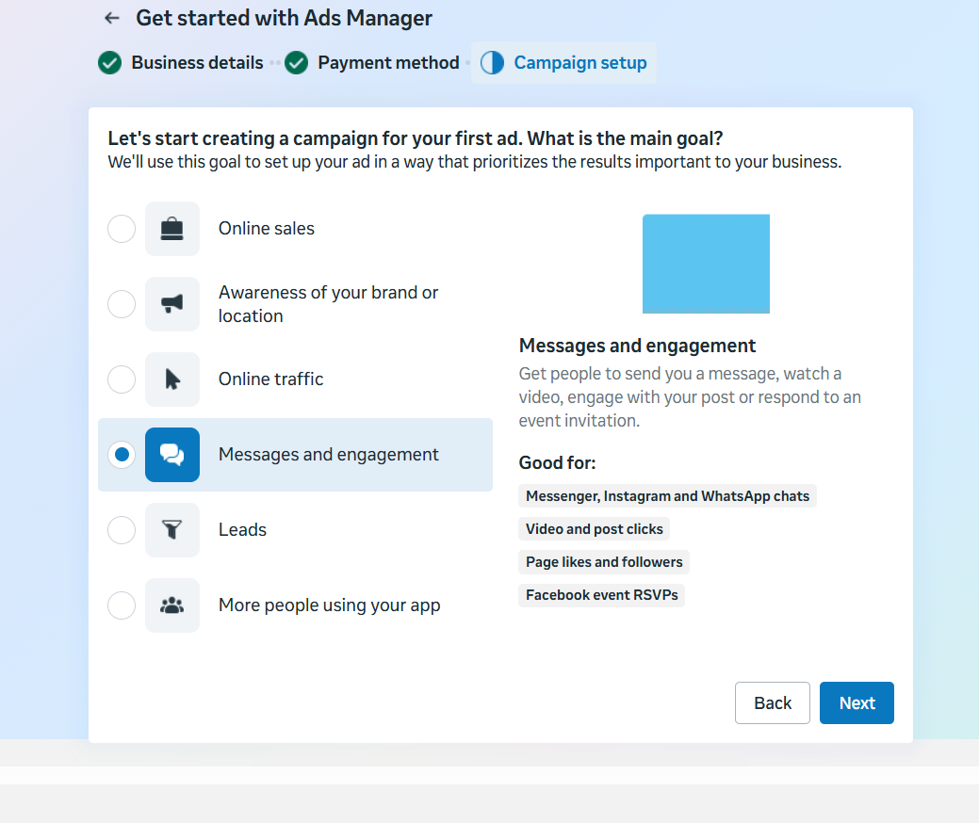
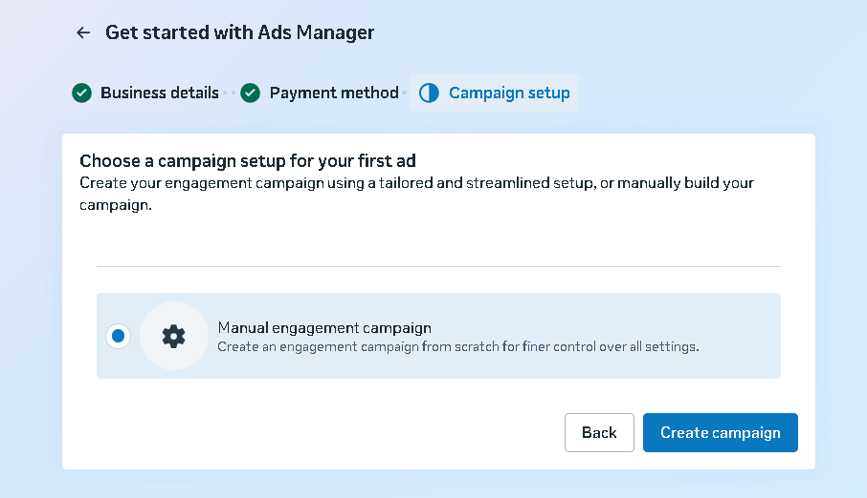
Campaign Setup – Manual Traffic

Slide 10
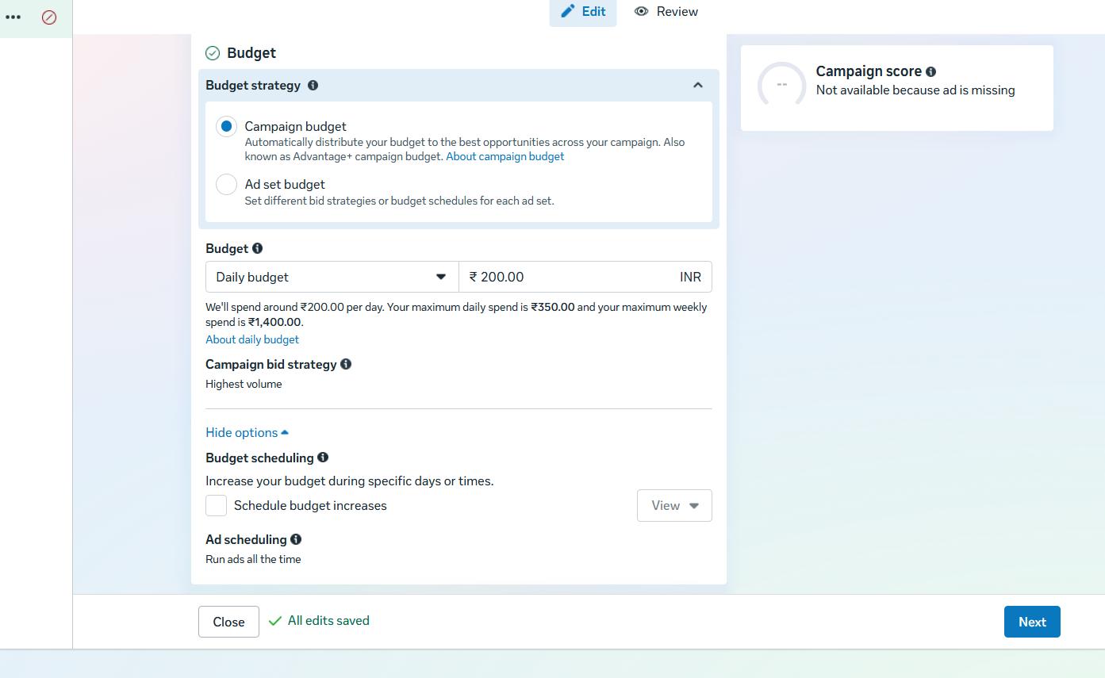
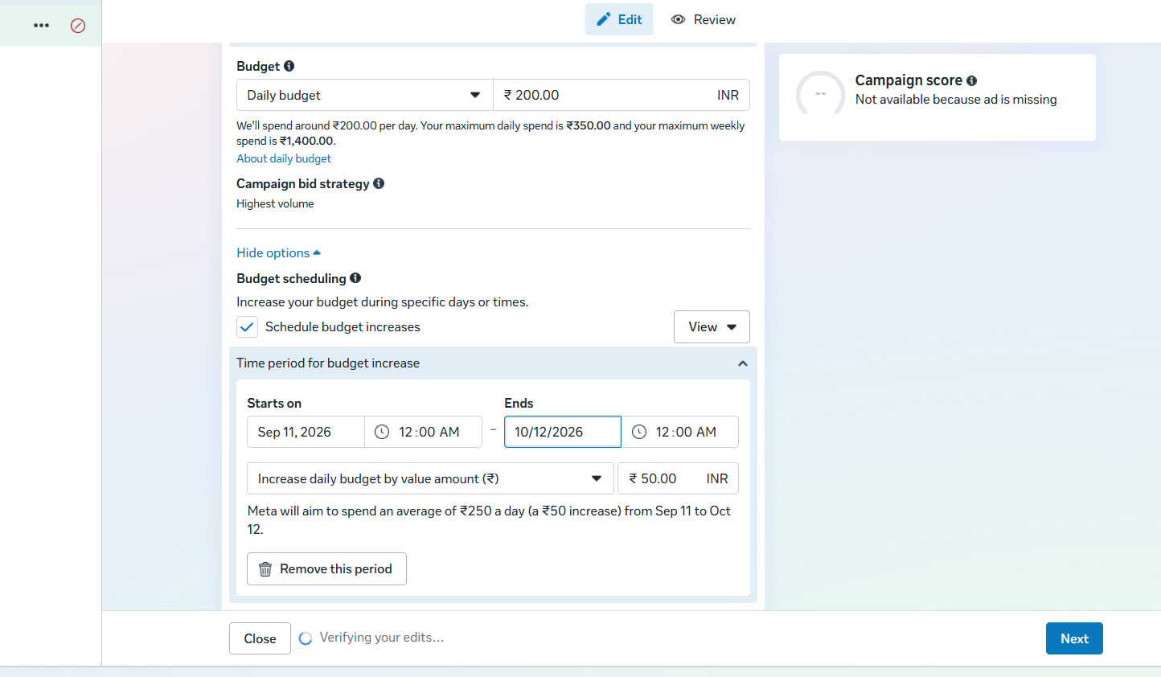
Budget Strategy & Bidding Selection

Slide 11
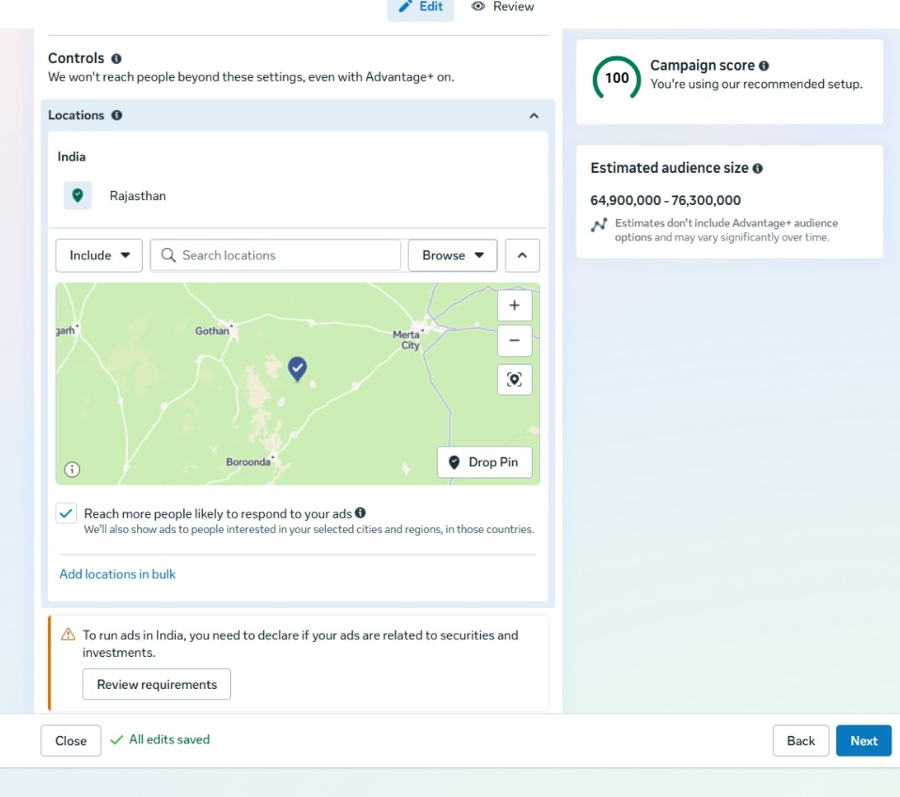
Location Targeting

Slide 12
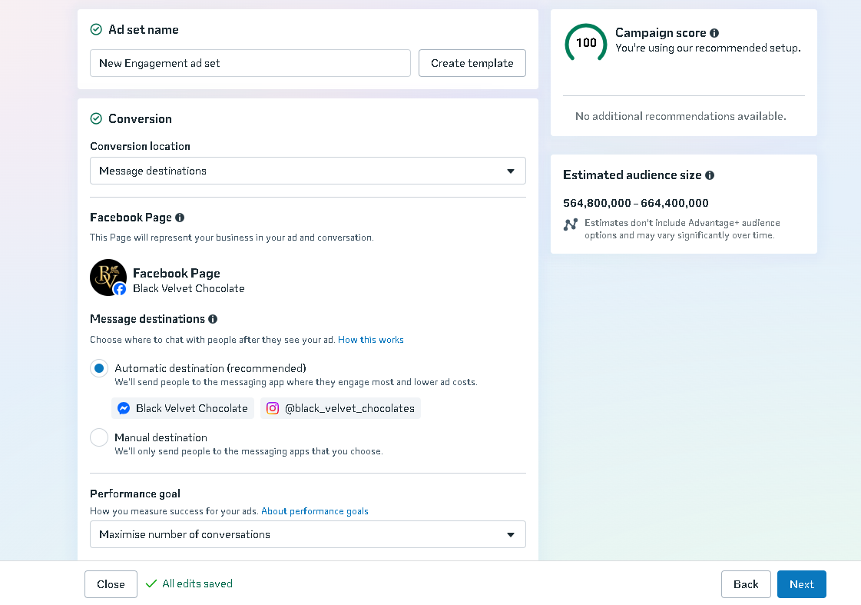
Conversion

Slide 13
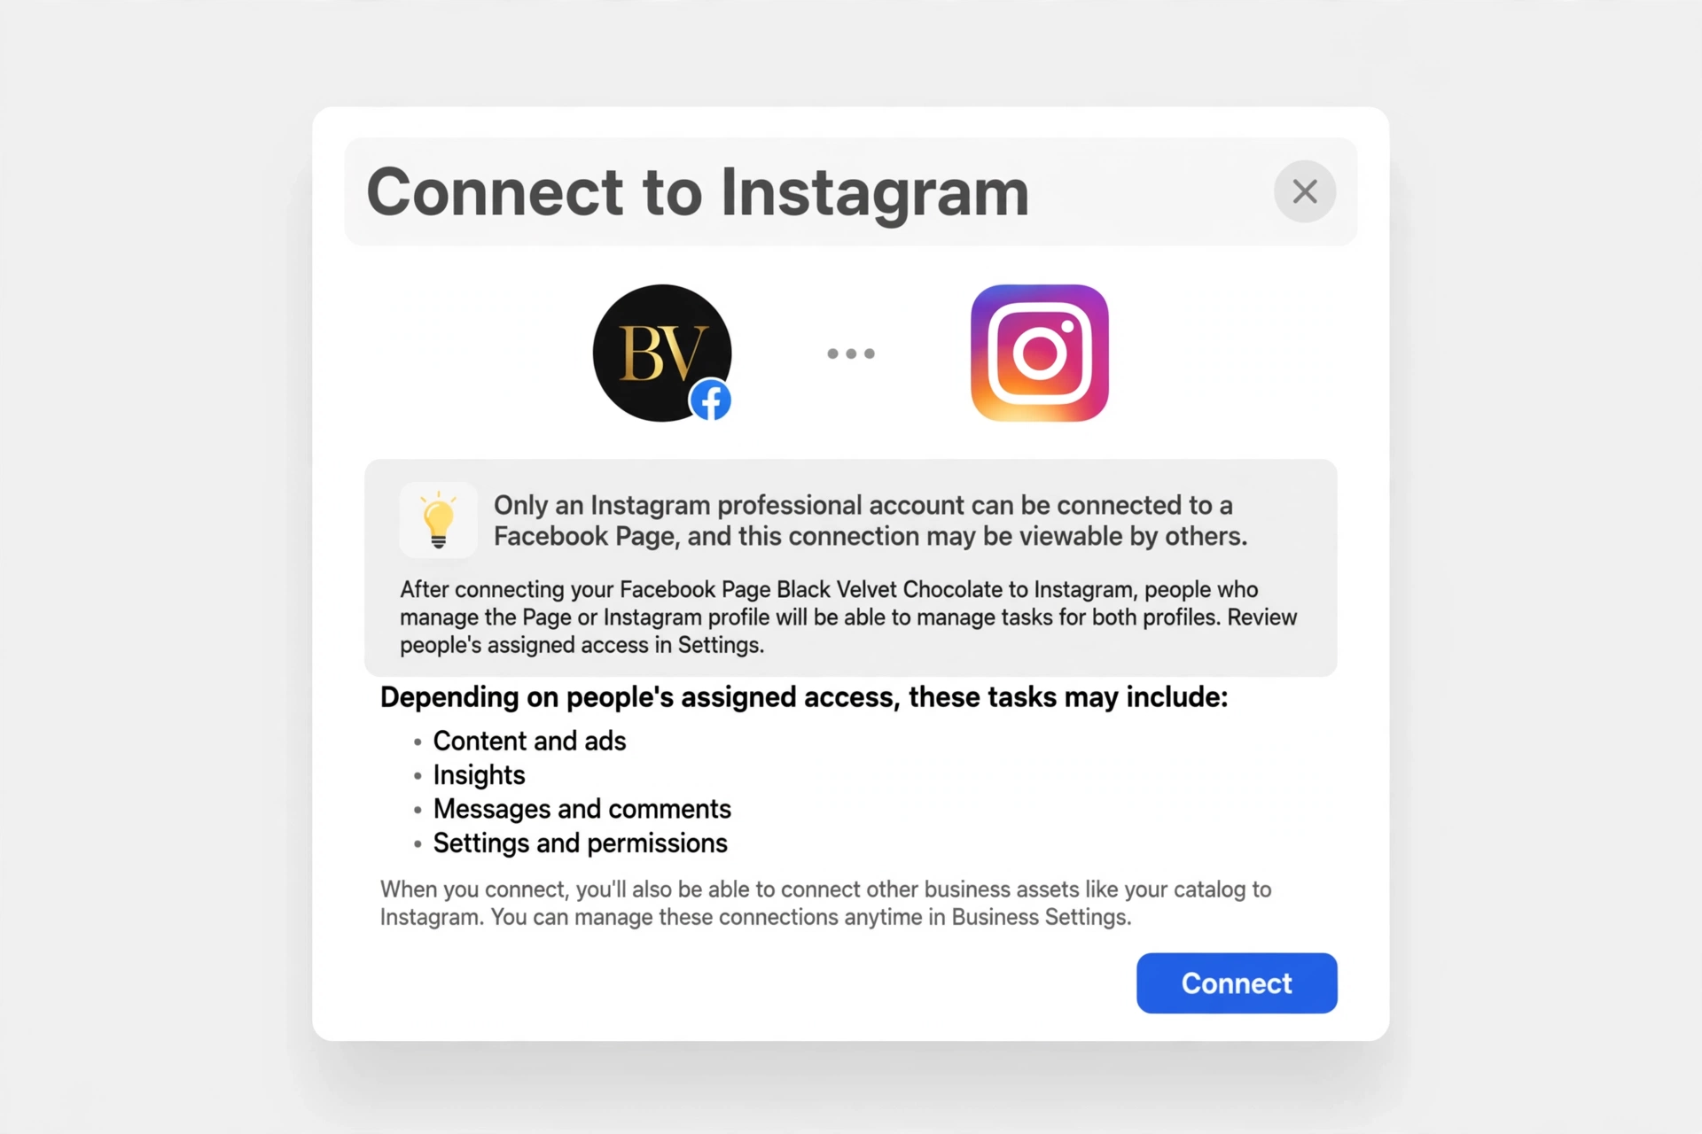
Instagram Connection

Slide 14
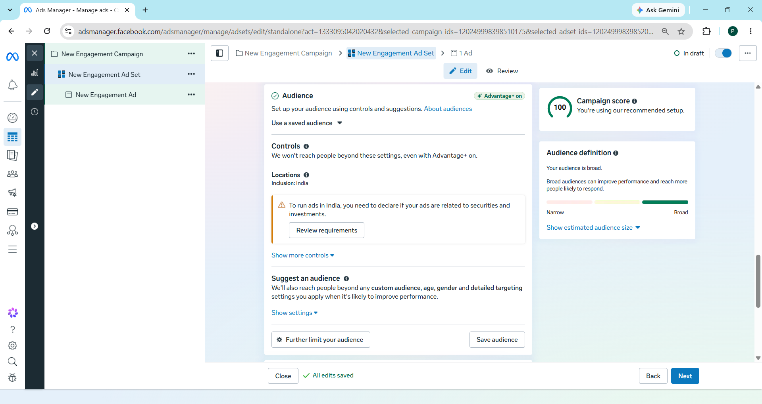
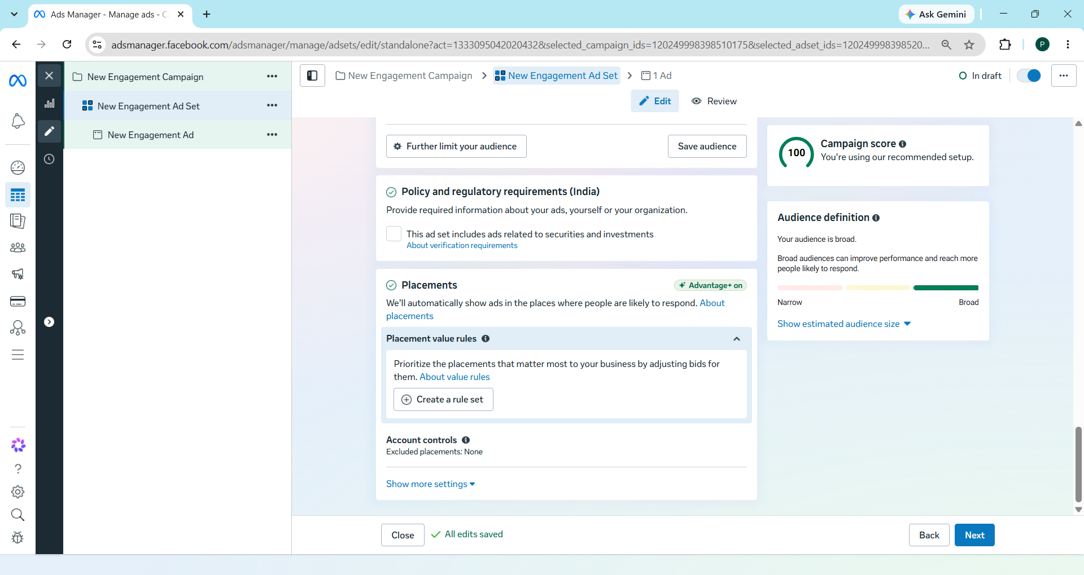
Audience Setup

Slide 15
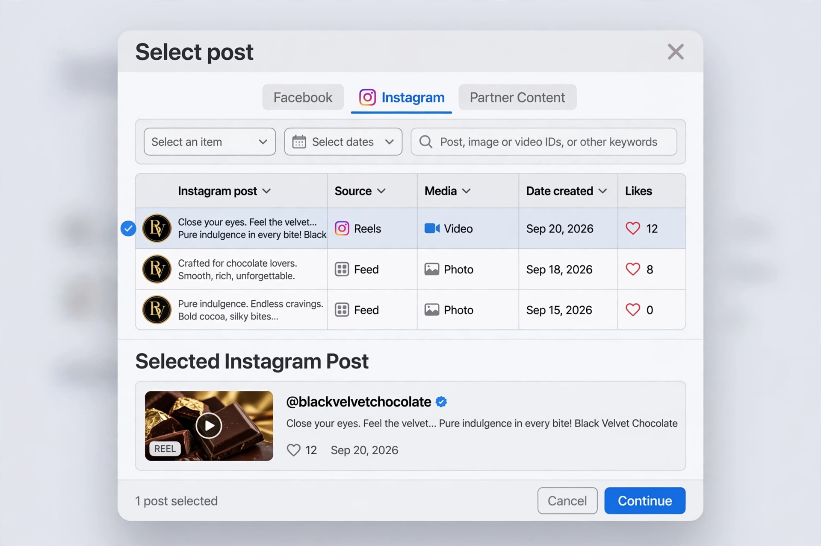
Post Selection for Ads

Slide 16
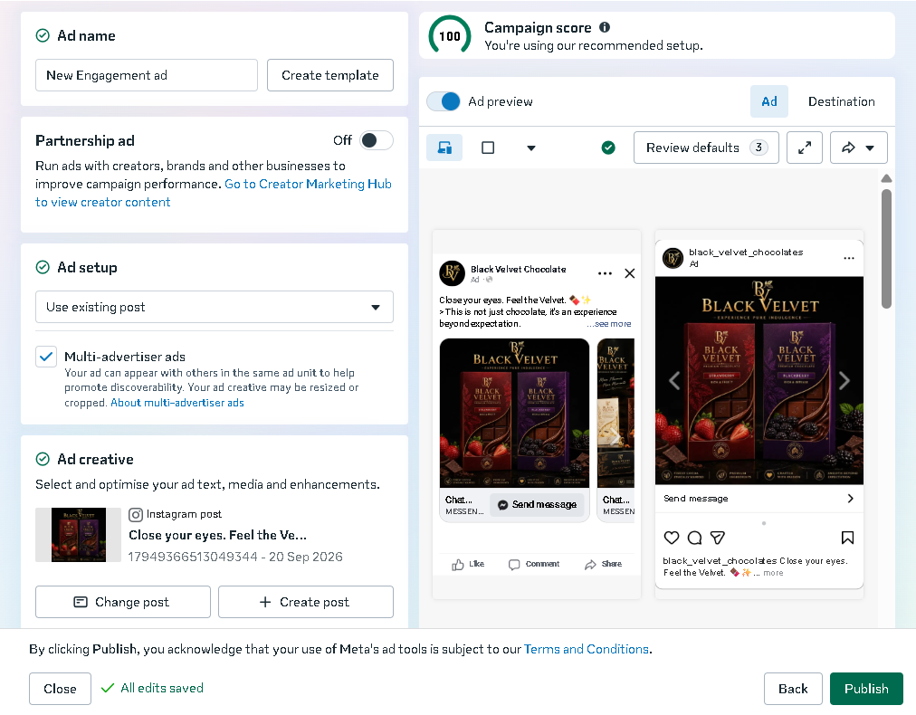
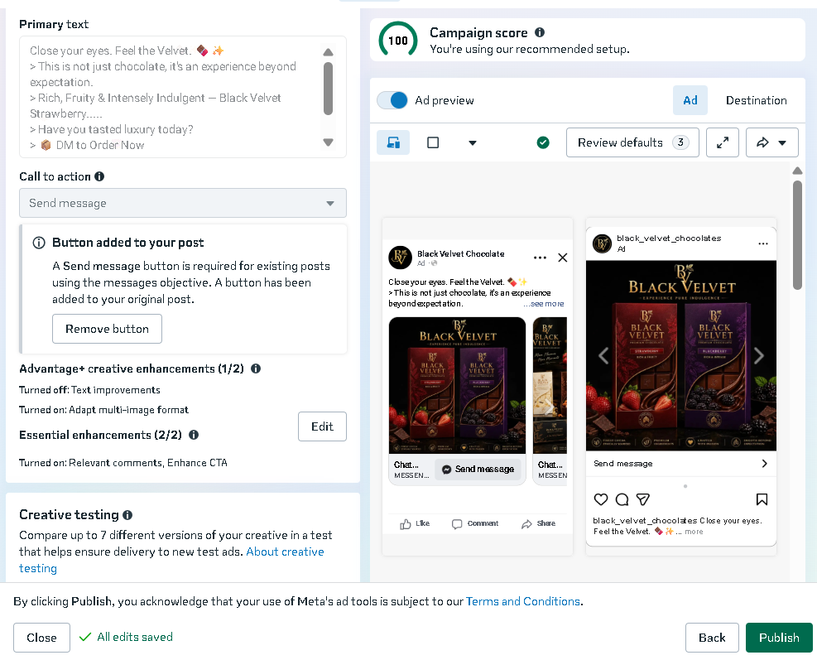
Final Ad Setup

Slide 17
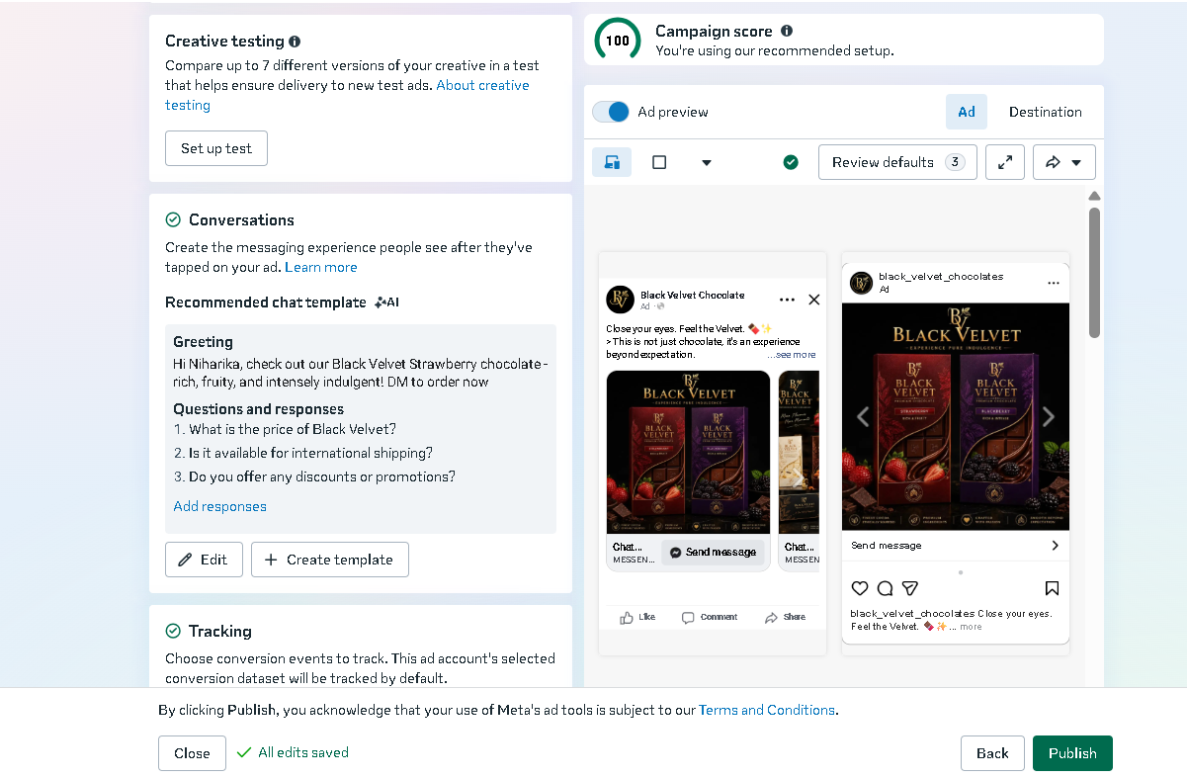
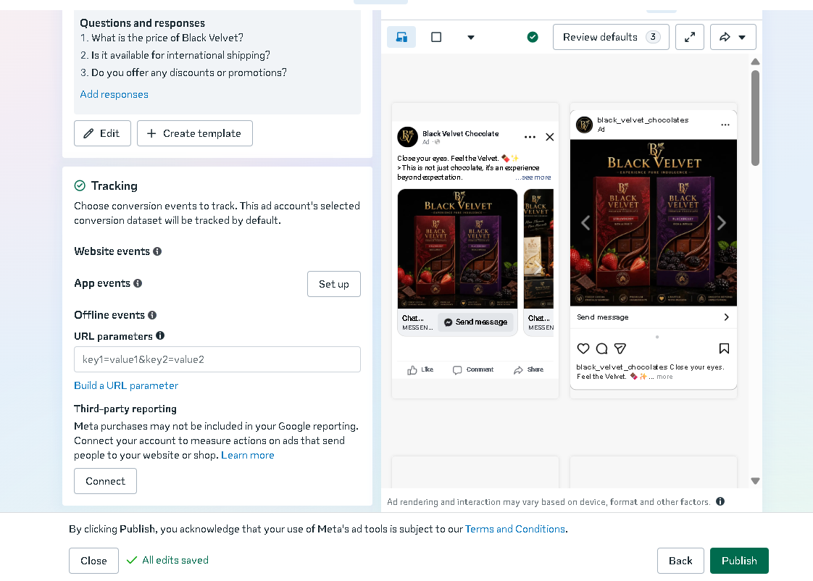
Conversations and Tracking

Slide 18
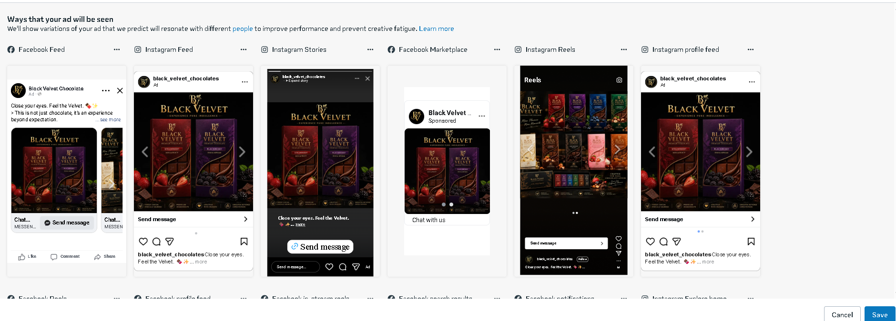
Final Ad Preview

